Slide 1
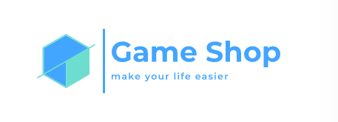
Kaloyan Dinev, 9B
Stanislav Todorov, 9V
Stoyan Kolev, 9A
Borislav Ferdinandov, 9G

Slide 2
Content
Our team
Idea of the project
Problems with it
Used programs, programming languages and apps for communication
Summary
Pros n Cons
Future ideas

Slide 3
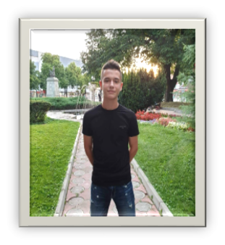
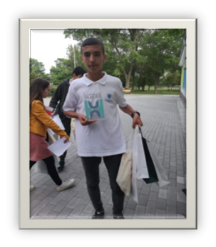
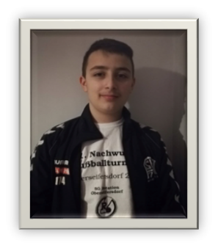


Meet our team
Borislav
Stanislav
Kaloyan
Stoyan

Slide 4


Idea of the project
To make a menu with a lot of options like adding games with a bunch of criterias, showing all games you’ve entered, edit their info and more!

Slide 5

Problems with the project
We did not stumble across many problems, only minor bugs with the code which we cleared really quickly.

Slide 6







Slide 7
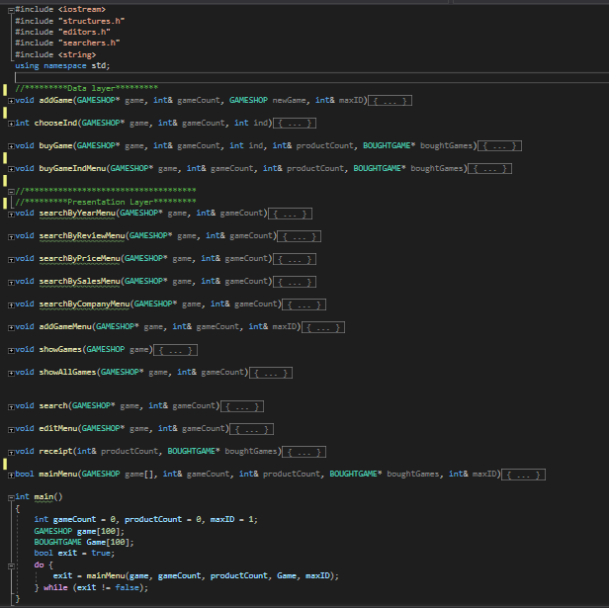
Summary of the program (not all functions included)

Slide 8
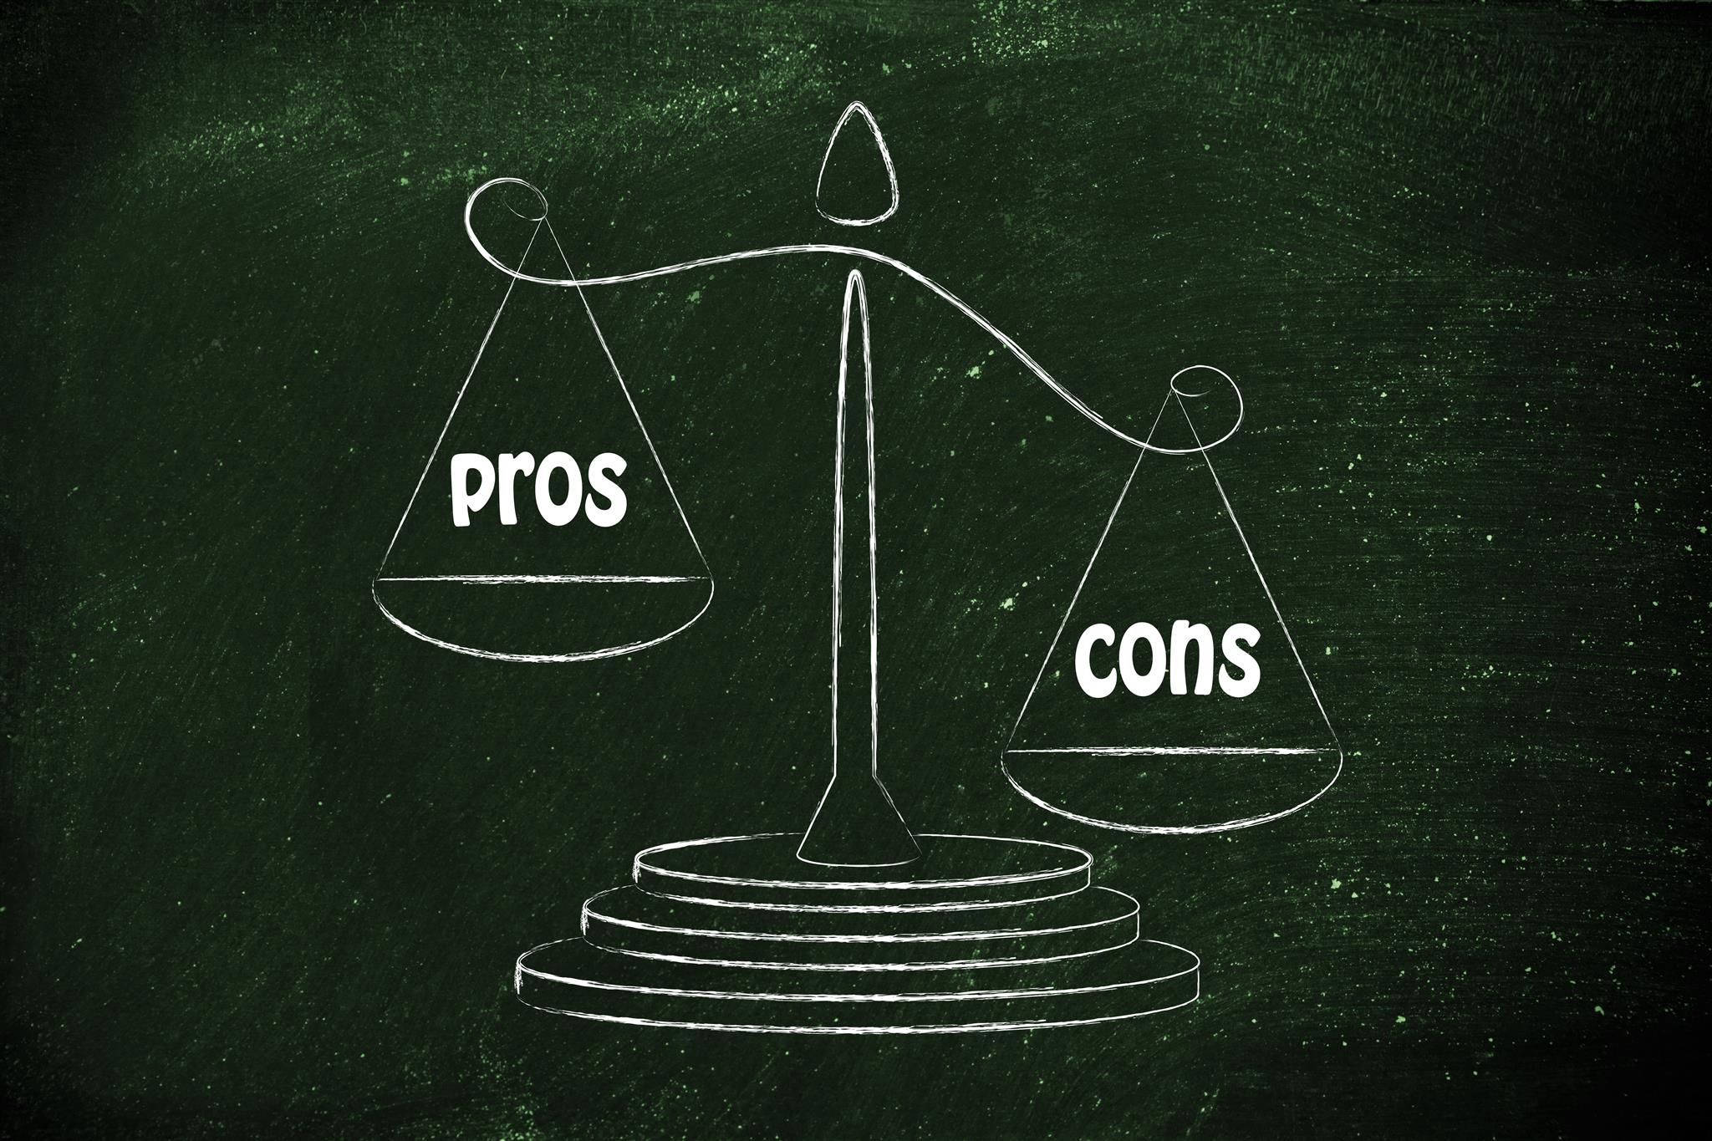
Advantages and disadvantages of the program
The advantages of the project: it makes the job of the shop-assistants easier and faster.
The disadvantages: The program is in an early stage of development

Slide 9


Data base
Login system
Discount function

Slide 10


